Slide 1





Understanding Viewer Preferences and Performance

Slide 2



Introduction
Objectives and Scope
Workflow
Data Collection and Loading
Data Cleaning
Data Analysis
Insights and Results

Slide 3



This project focuses on analyzing Netflix data to uncover viewer behaviors and content trends.
By refining data types, resolving inconsistencies, and leveraging SQL queries, the analysis aims to provide actionable insights for optimizing content strategies and enhancing user experience on the platform.

Slide 4



Enhance Data Quality and Consistency
Deepen Understanding of Viewer Preferences
Optimize Operational Efficiency
Drive Strategic Decision-Making
Enhance Data Quality and Consistency Deepen Understanding of Viewer Preferences Optimize Operational Efficiency Drive Strategic Decision-Making

Slide 5












Slide 6
Data Sources
Netflix dataset containing information about movies, TV shows, directors, cast, genres, countries, duration, and ratings.
Data Loading Process
Data was initially loaded into Python for preprocessing and then imported into the raw data layer of SQL Server.

Slide 7



Slide 8


Converted ‘title’ column from ‘varchar’ to ‘nvarchar’ to support foreign characters.
Ensured visibility and correct representation of all characters in titles.
Determined optimal column lengths using Python to improve loading speed.
Changed from max length to required length for efficient data handling.
Identified ‘show_id’ as unique across the dataset.
Established ‘show_id’ as the primary key to ensure data integrity and uniqueness.

Slide 9


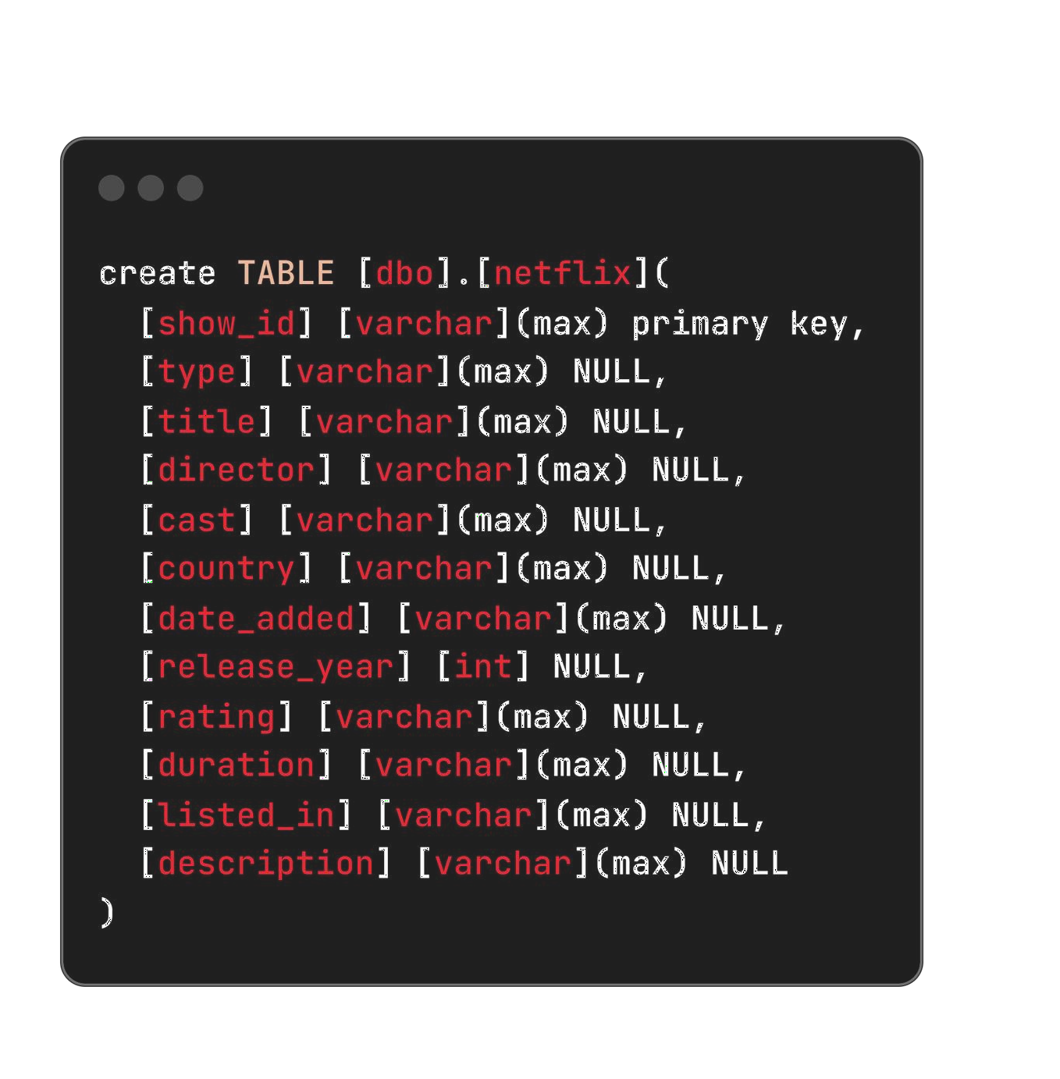
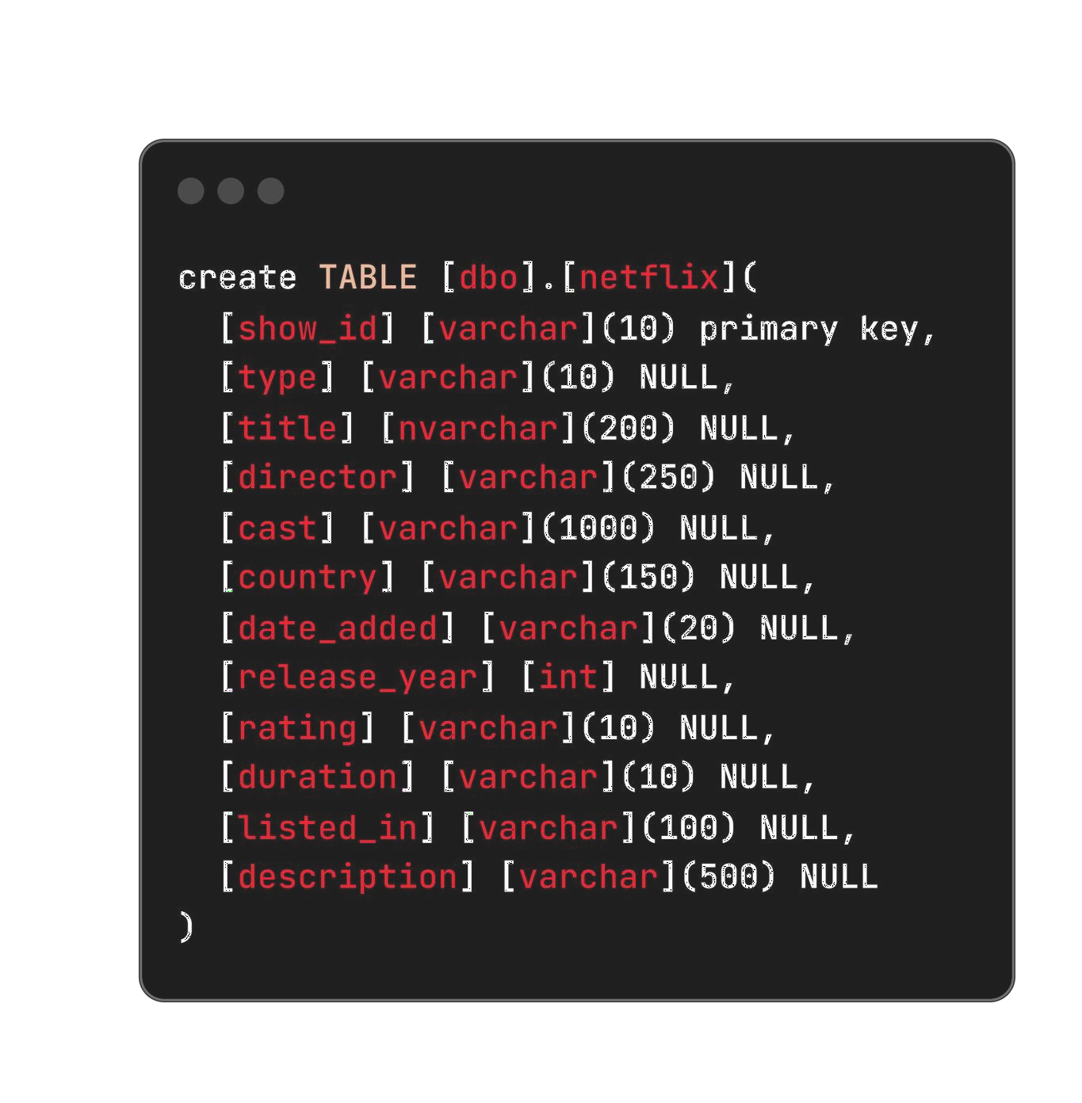

Slide 10
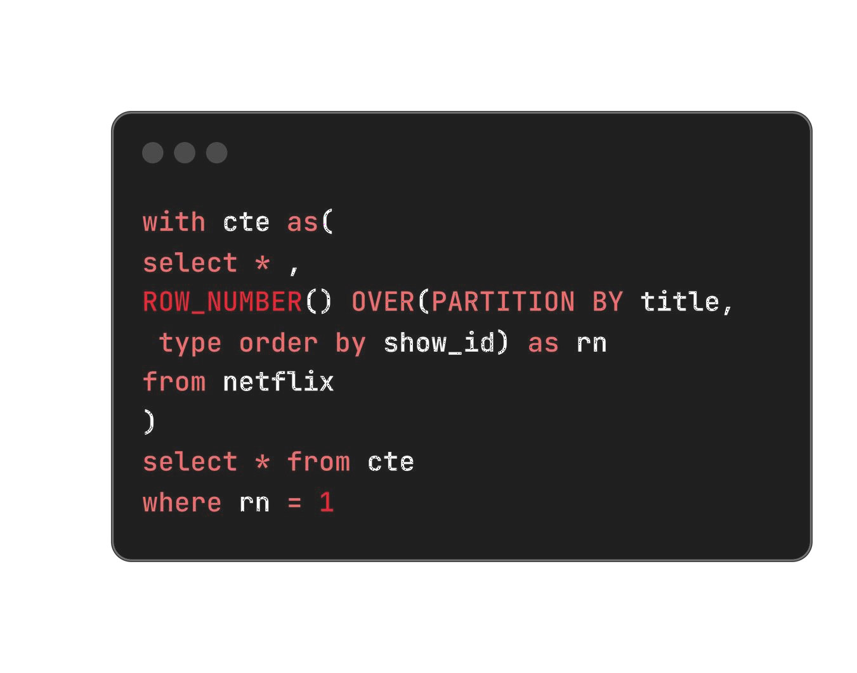


This SQL query efficiently selects only unique rows for each title in the Netflix data table by assigning row numbers partitioned by title, thereby ensuring duplicates are handled appropriately.

Slide 11

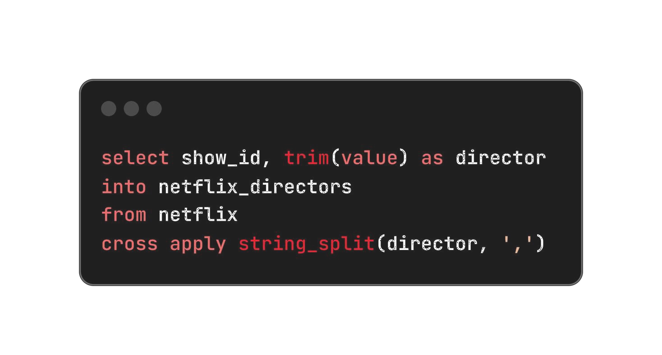
To improve data structure and normalization, columns containing multiple values separated by commas were refactored into separate tables. This enhances data integrity and allows for more efficient querying and analysis of individual values.

Slide 12
show i
f
(
) genre
show_id ,
(
) cast
netf1îx_gen re
netf1îx_cast
neïflix
netf1ix
(listed in,
)
(cast ,
)
show_îd , ( netftix countries netflix
) count:r'y
(country,
)

Slide 13
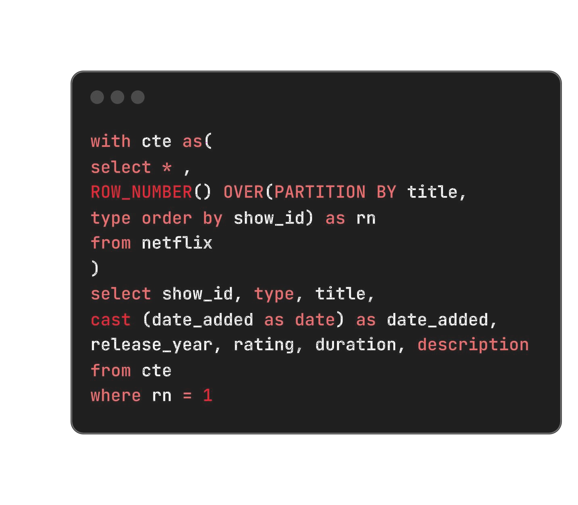



The data type of the "Date Added" column was changed from varchar to date to enhance data consistency and facilitate accurate date handling.

Slide 14
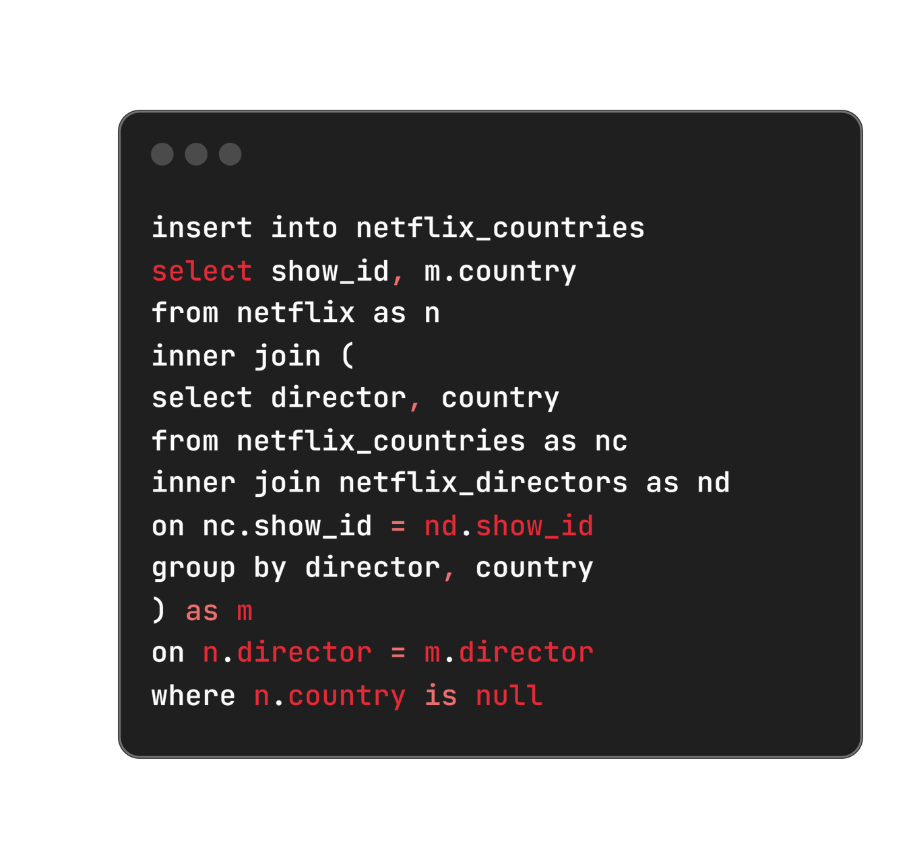



Null values in the "Country" column were filled by analyzing the "Director" column, assuming that directors typically create content in their own country.
This approach improves data completeness and enhances geographical insights within the dataset.

Slide 15
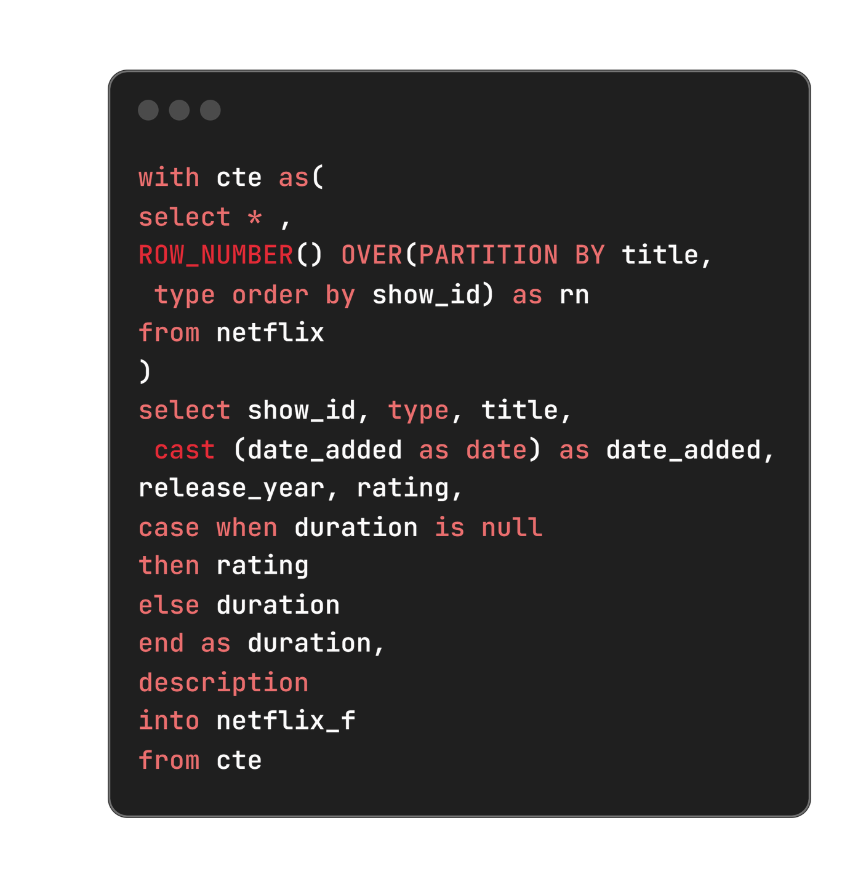


An issue was identified where null values in the "Duration" column were incorrectly placed in the "Rating" column. This discrepancy was resolved using a ‘CASE’ statement, ensuring that each column contains the appropriate data without compromising data integrity or analysis accuracy.

Slide 16


Slide 17
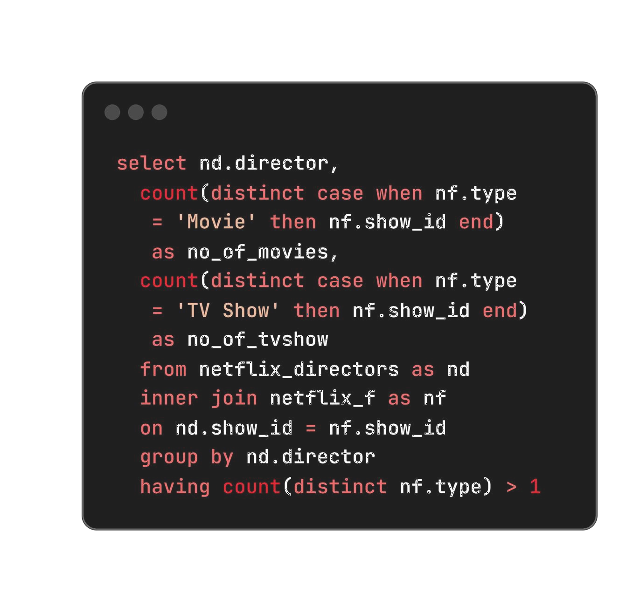












Slide 18



Abhishek Chaubey | 4 | 1
Alastair Fothergill | 1 | 3
Alban Teurlai | 1 | 1
Alessandro Angulo | 1 | 1
Andrew Tan | 1 | 1
Anurag Kashyap | 8 | 1

Slide 19
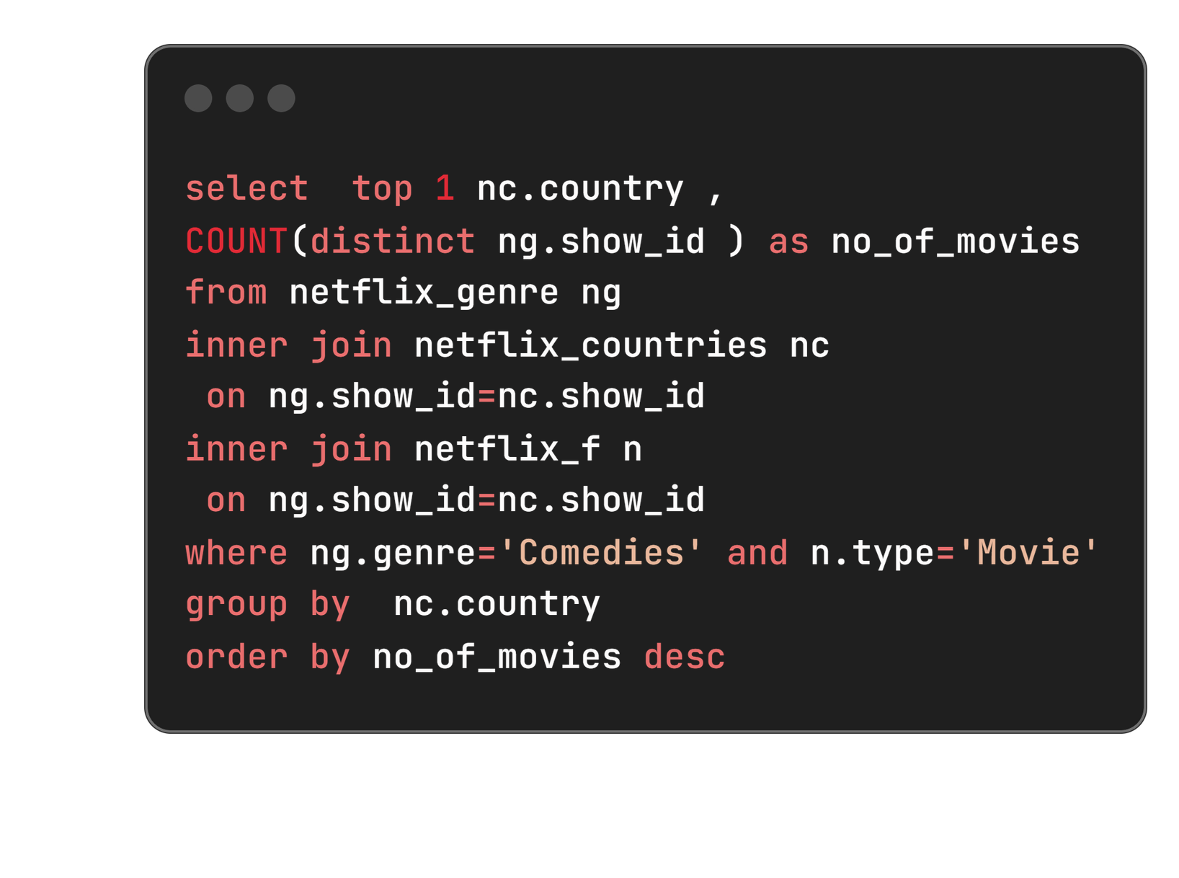





United States | 685

Slide 20
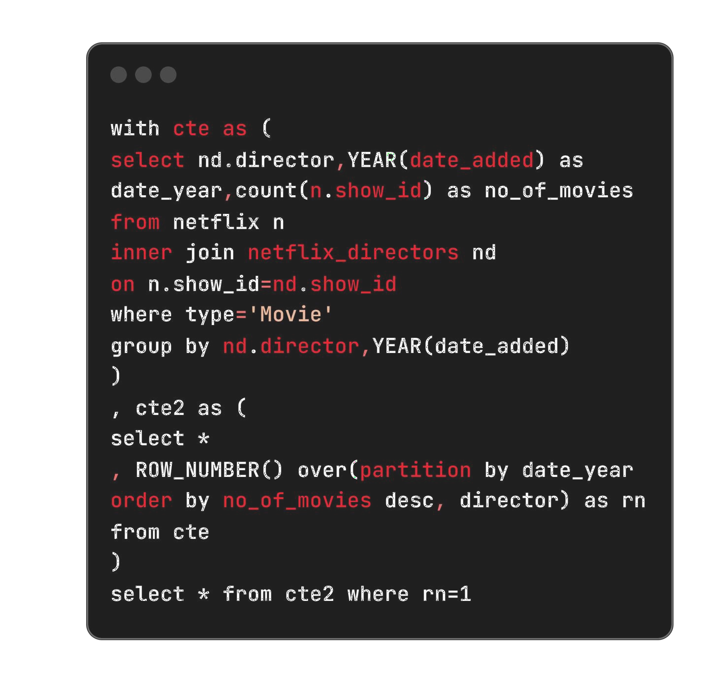







Slide 21


Jan Suter | 2016 | 4
Jay Chapman | 2017 | 7
Jan Suter | 2018 | 12
Cathy Garcia-Molina | 2019 | 7
Youssef Chahine | 2020 | 11
Rajiv Chilaka | 2021 | 17

Slide 22








Slide 23
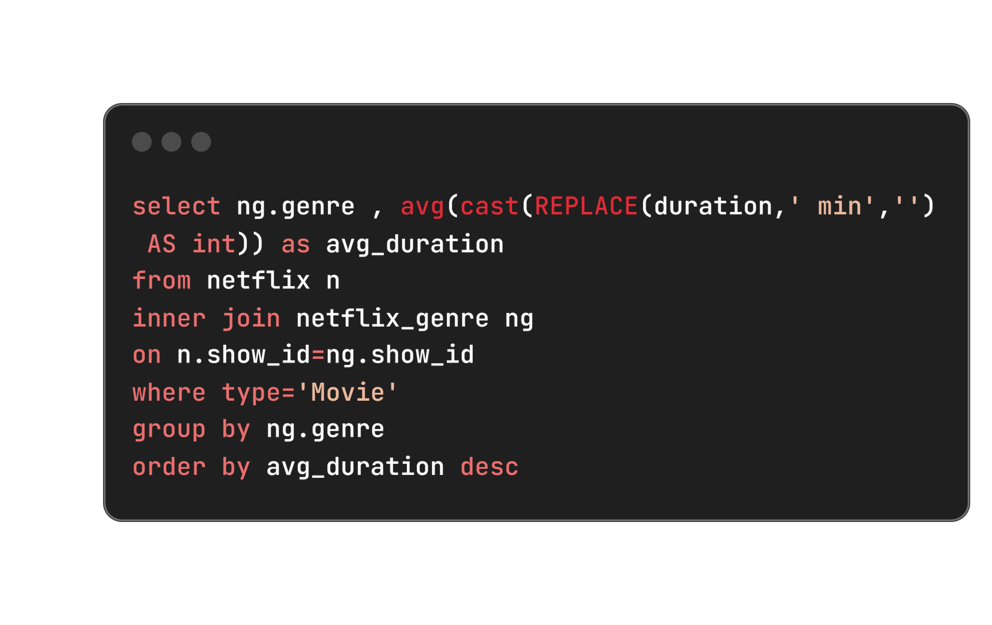




Slide 24








Slide 25
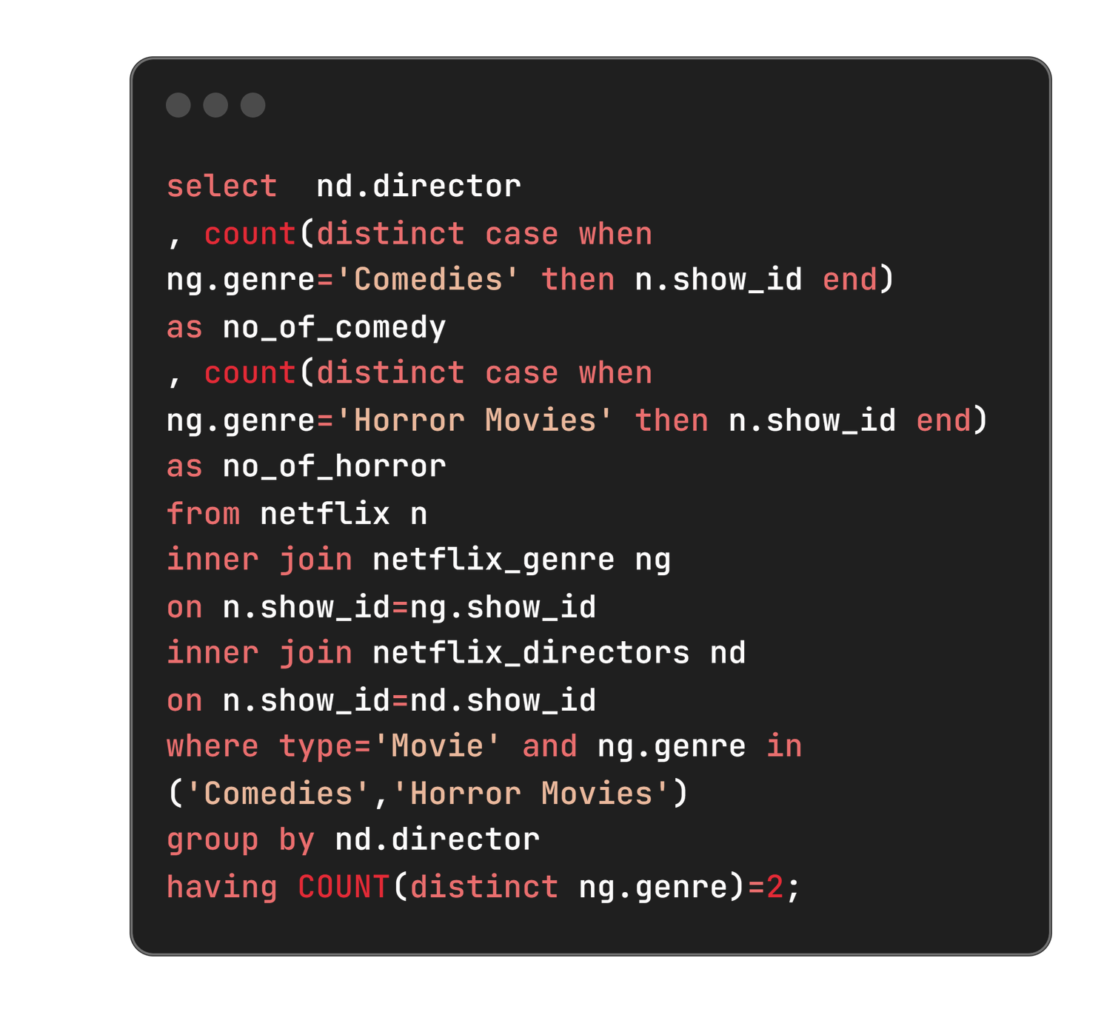










Slide 26


Banjong Pisanthanakun | 1 | 3
Don Michael Paul | 3 | 3
Jeff Baena | 2 | 1
Kevin Smith | 5 | 3
Michael Tiddes | 4 | 2
Poj Arnon | 3 | 5

Slide 27



Slide 28

Content Preferences: Highlighted the popularity of comedy movies in the United States, guiding localized content acquisition strategies.
Directorial Excellence: Recognized prolific directors and their impact on Netflix’s
content diversity and viewer engagement.
Genre Analysis: Provided insights into viewer preferences based on genre and average duration, informing content curation strategies.

Slide 29

Enhanced Content Relevance:
Targeting popular genres like comedy in the United States improves viewer engagement.
Strategic Partnerships
Collaborating with top directors diversifies content and attracts broader audiences.
Operational Efficiency
Optimizing content length enhances viewer satisfaction and retention.
Informed Decision-Making
Data-driven insights enable precise resource allocation and competitive positioning.

Slide 30
For exploring this presentation on the Netflix data analysis project. Your interest and engagement are greatly appreciated as we continue to uncover valuable insights from the data.

